Slide 1


Dine Line
Tradition in Every Sip. Modern in Every Move.
Candidates :
Koshika T (713323CD025)
Kirthik Kumar S (713323CD024)
Mohammed Afsal B (713323CD029)
Department Of Computer Science & Design
SNS College Of Engineering, Coimbatore

Slide 2


Problem Statement
Daily Harvest is facing challenges in scaling its meal delivery service to handle increased customer demand while managing supply chain logistics and maintaining product quality and freshness.
Description: Daily Harvest needs to scale its meal delivery service to meet growing customer demand, optimizing supply chain logistics and ensuring high product quality and freshness.
Unicorn Problem Statement Number : 38

Slide 3
Introduction
The drink delivery industry is growing fast as more people want convenient, healthy, ready-to-drink options, putting pressure on companies like Daily Harvest to expand smoothly.
As demand grows, handling the supply chain, production, inventory, and delivery becomes harder, so companies need smart planning and better systems.
Delivering fresh drinks needs strong quality checks and temperature control to make sure customers always get fresh and high-quality products.

Slide 4


Empathy
Customers don’t have time to make drinks but still want something healthy and easy.
Most drink delivery apps don’t offer enough healthy or satisfying options.
People worry about the freshness, quality, and nutrition of the drinks they get.
They feel tired of the same unhealthy drinks and struggle to balance work, life, and health.
Even with doubts, they still hope for a healthy, affordable drink option that matches Indian tastes.

Slide 5
Empathy
Says
I don’t have time to cook but still want to eat healthy.
There’s nothing on food delivery apps that’s healthy and filling.
Meal kits are too foreign — I want something familiar and quick.
Why is healthy food always so expensive or boring?
Thinks
I need to take care of my diet, but I can’t spend hours cooking.
Will this service be reliable and actually deliver fresh food?
Is this food nutritious or just another marketing gimmick?
What if I don’t like the taste or it doesn’t match my routine?
CUSTOMER
Does
Scrolls through food delivery apps looking for healthy options Buys groceries but often ends up wasting them Occasionally tries DIY healthy recipes, but struggles to be consistent Watches fitness or health food content on Instagram/Youtube
Feels
Frustrated with current food options — too oily, repetitive, or unhealthy
Overwhelmed balancing work, life, and cooking
Skeptical but curious about meal subscriptions
Hopeful for a solution that’s healthy, convenient, and Indian-friendly

Slide 6
Define
Daily Harvest needs a way to grow its drink delivery service while keeping drinks fresh, high-quality, and trustworthy.
The main issue is managing high demand with a limited supply chain, which leads to delays and uneven drink quality.
Customers want healthy, affordable, and familiar drinks without the effort of making them or buying ingredients.
The big challenge is creating a system that keeps drinks reliable, fresh, and convenient while staying cost-friendly and fitting the Indian market.

Slide 7
Objective
To build a smart drink delivery platform that keeps drinks fresh and high-quality using real-time temperature and delivery tracking.
To use AI to predict customer demand, helping reduce waste, manage production better, and support smooth business growth.
To design an easy-to-use drink delivery app for Indian customers that offers healthy, affordable, and familiar drink options with reliable service.

Slide 8
Ideate
Smart Cooling System: Use IoT sensors to keep drinks at the right temperature during storage and delivery, making sure they stay fresh and tasty.
AI Demand Prediction: Use AI to study past orders and predict what drinks customers will want next, reducing waste and improving delivery speed.
Personalized Drink Choices: Create a system that lets users choose healthy, affordable, and Indian-style drinks based on their taste and preferences.

Slide 9
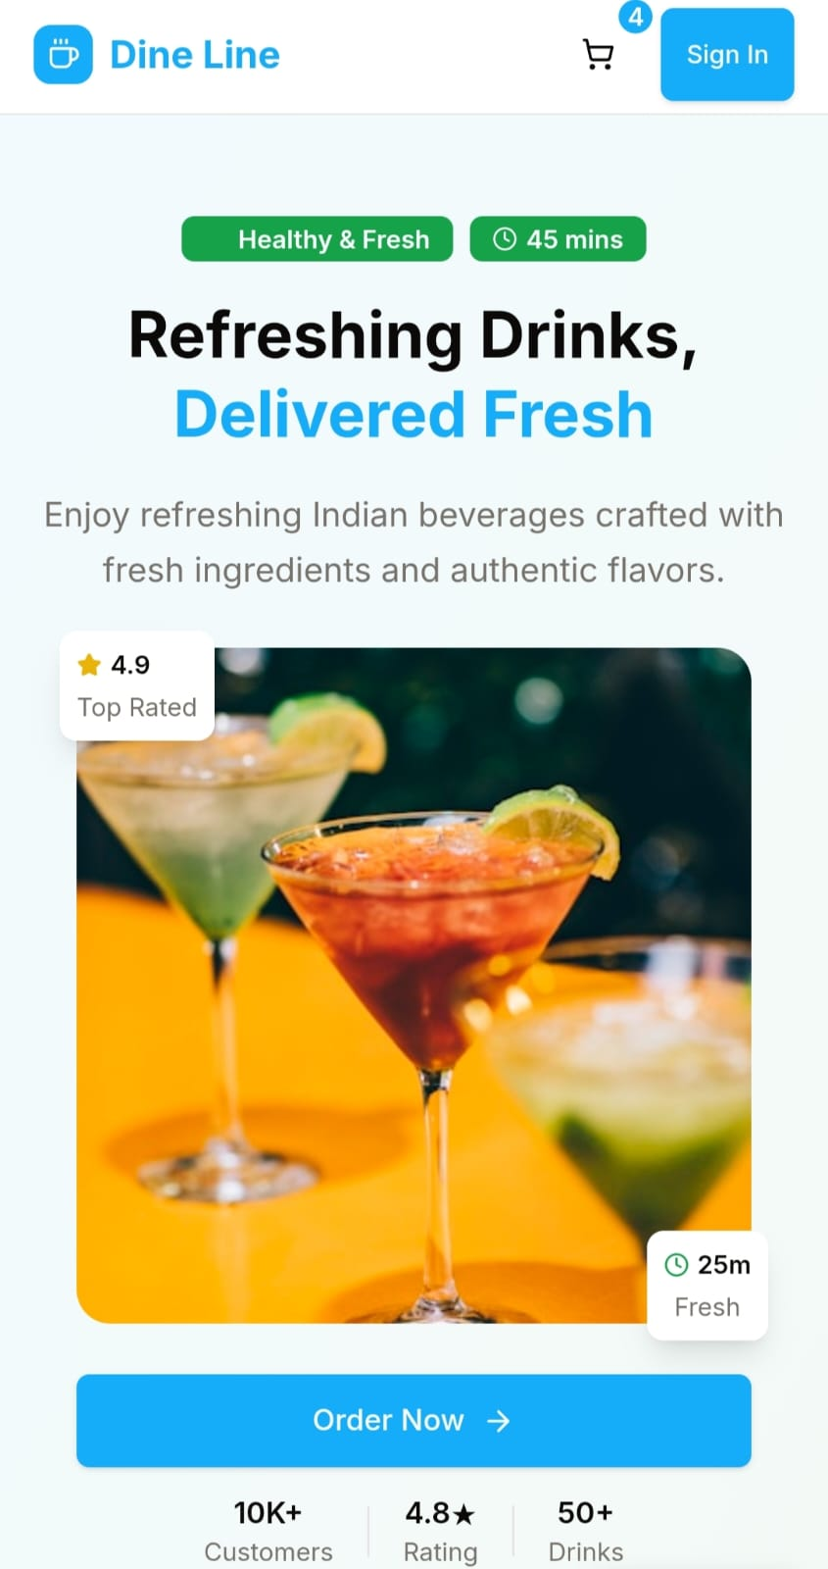
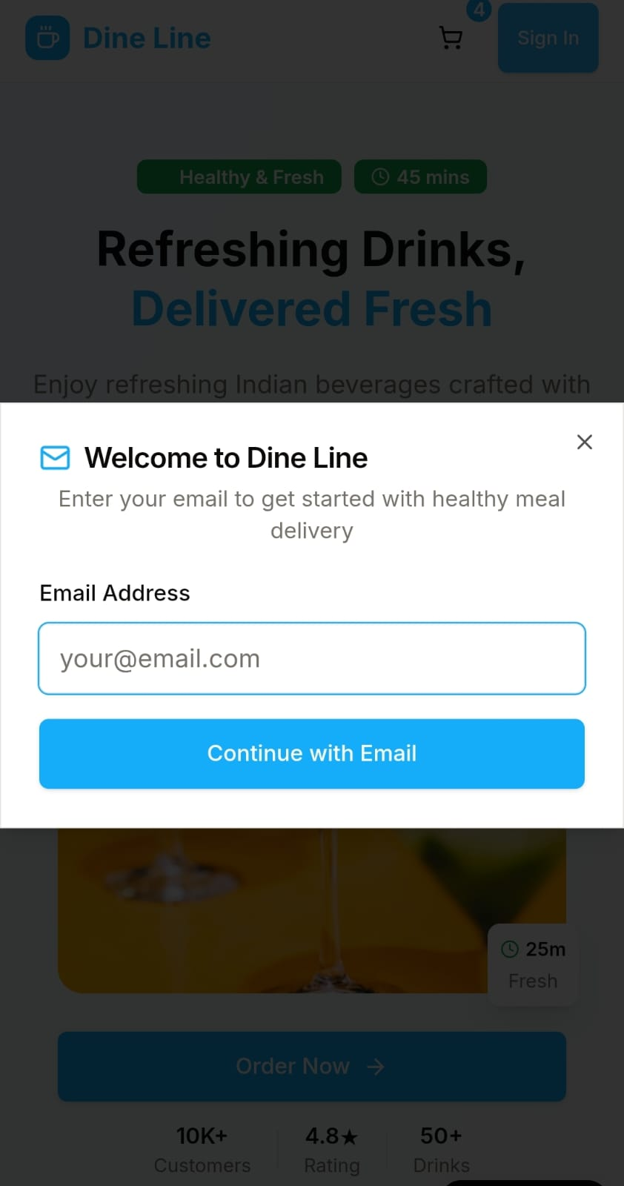
Prototype

Slide 10
Conclusion
Enhanced Efficiency and Freshness: The project ensures timely delivery and consistent food quality through IoT-based monitoring and route optimization.
Data-Driven Operations: AI forecasting enables smart planning, reduced wastage, and scalable business growth in the meal delivery sector.
Customer-Centered Design: Dine Line provides healthy, affordable, and culturally familiar meals, building trust and satisfaction among users.

Slide 11

THANK YU

